Slide 1

Tamaclonechi
CSC 335: Final Project
Austen Connick
David Izmailov
Fernando Ruiz
Noah Silverman

Slide 2
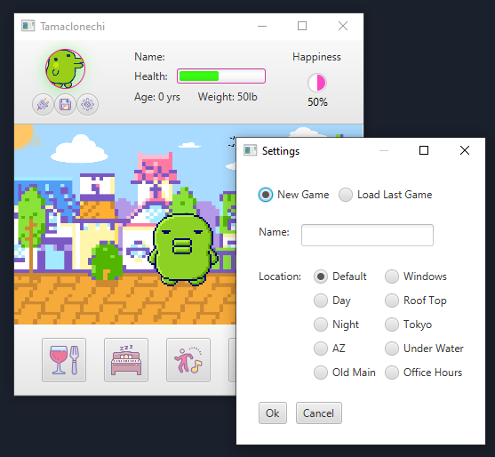
Game Overview
Creating a new game or Opening a saved game
The user is allowed to start a new game or resume a saved game via pressing a settings buttons at the top-left of the program screen.
In this settings screen, the user can choose if they want to load the last saved game or create a new game, where they can enter a new name and choose a location for the pet.

Slide 3
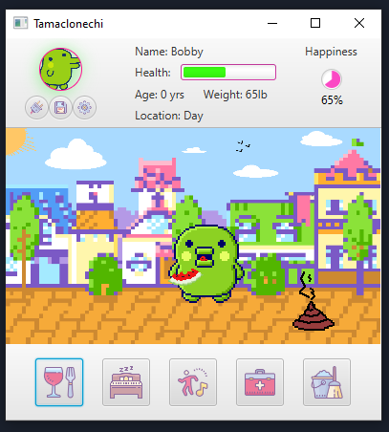
Game Overview
Caring for your pet
During gameplay, the health of the pet is calculated by analyzing different aspects of the pet and caring for it. The overall health of the pet is a culmination of the pet’s happiness, weight, and eating schedule.
The health of the pet naturally deteriorates, and the deterioration accelerates when the pet doesn't eat, sleep, or get medicated.
To increase the health of the pet, the user can feed their pet, let it sleep, medicate it, clean it, and let it dance. This is accomplished by clicking one of the buttons in the bottom of the program.

Slide 4
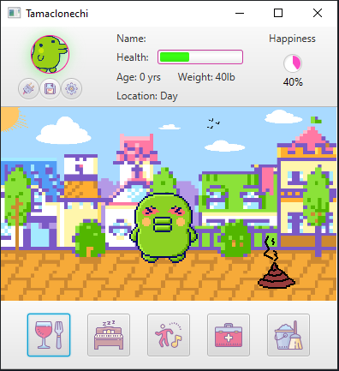

Game Overview
Pet health and wellness
Every so often the pet will defecate and need to be cleaned, and until that is done, the pets health will slowly deteriorate.
If the pet’s happiness is unattended, the pet will begin to cry after a certain time.
The pet can also become sick and if unattended it may die.

Slide 5
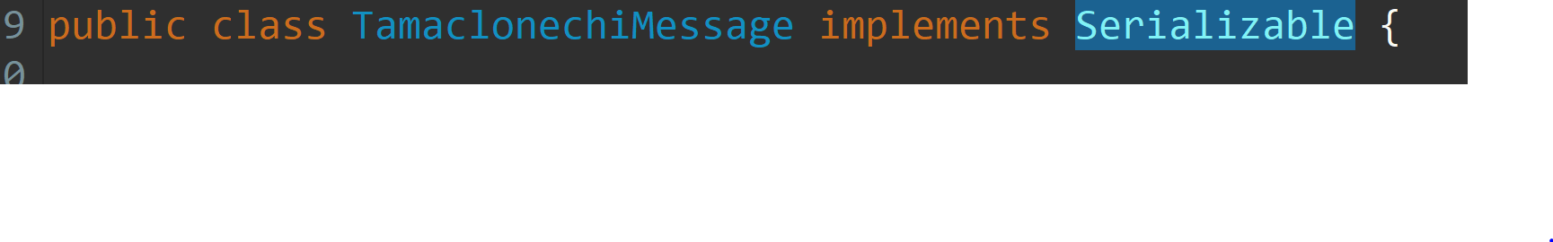
Design Choices
Model-View-Controller
Live time progression
Sprite Animation
Threading
Observer/Observable
Serializable

Slide 6
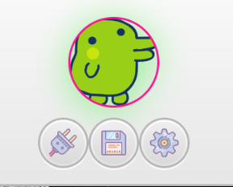
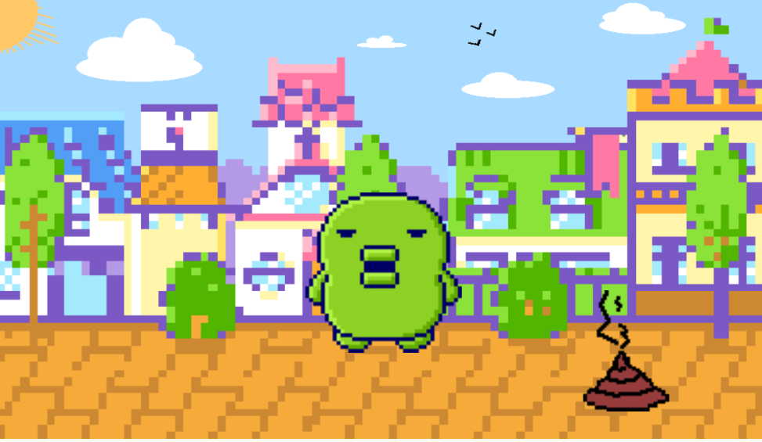
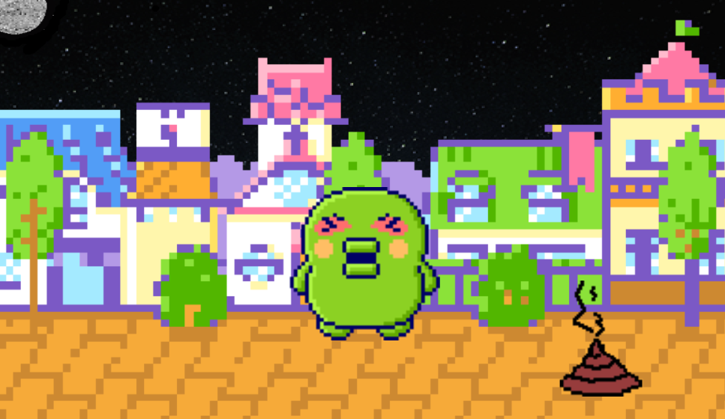
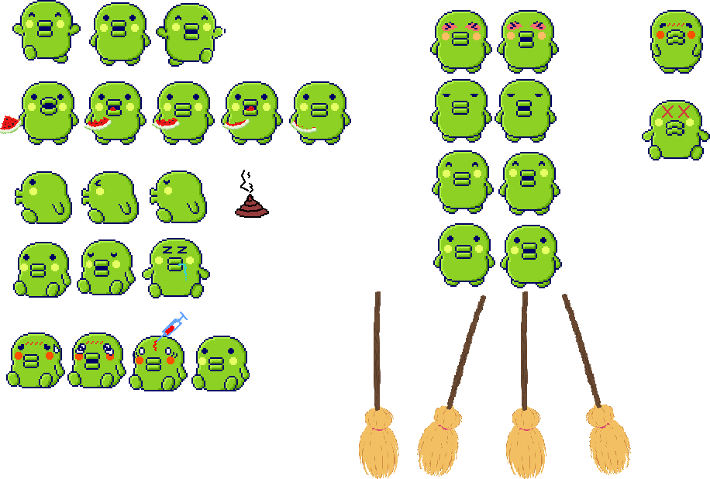
Wow Factor
Auto Saving at every 1 year of age (around 15 - 20 mins).
Wide selection of backgrounds to choose from! (10 )
3 custom backgrounds (Day, Night, and Office Hours)
5 custom-made animations and 1 static for idle, based on stats.
(sick, happy, sad, mad, annoyed and dead (static) )
6 custom-made animations for action, based on button press and timers.
(eat, clean, sleep, dance, and defecate).

